Slide 1
SECoP@HMC – Data Storage
Making sample environment (meta)data understandable

Slide 2

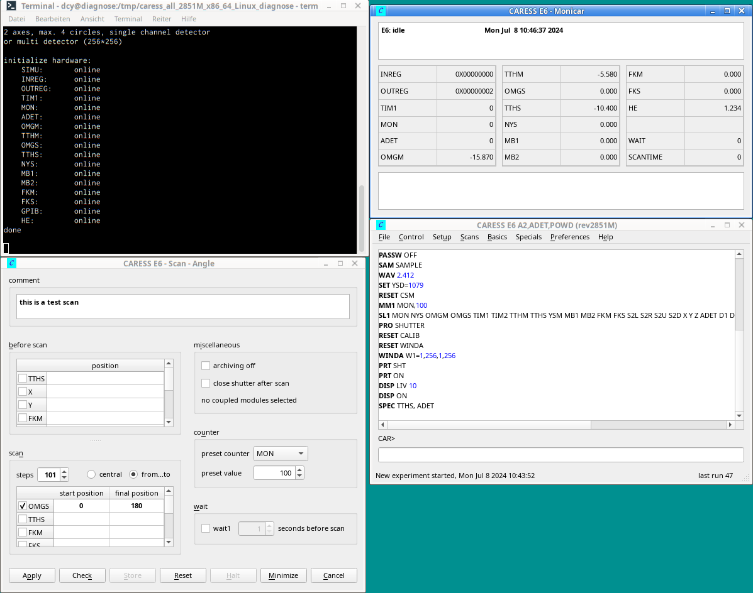
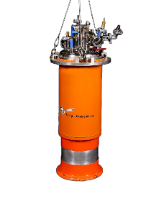
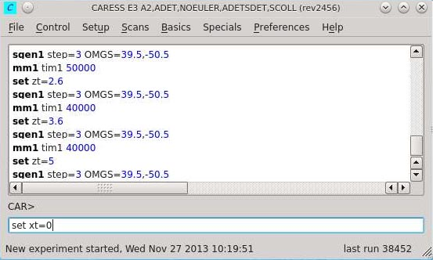

Sample Environment Communication Protocol
Experiment Control
Sample Environment

Slide 3

Sample Environment Communication Protocol
Experiment Control
Sample Environment
SECoP
Sample Environment
+ SECoP Server (SECnode)
Experiment Control
+ SECoP Client

Slide 4

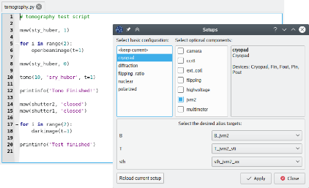
Sample Environment Communication Protocol
Experiment Control
Sample Environment
SECoP
Sample Environment
+ SECoP Server (SECnode)
Experiment Control
+ SECoP Client
SECoP
Experiment Control
+ SECoP Client
Sample Environment
+ SECoP Server (SECnode)

Slide 5
Sample Environment Communication Protocol
Experiment Control
Sample Environment
Metadata to describe SE sufficiently:
Model / kind (cryo, magnet…)
Parameters to read
Parameters to set (+ limits)
Units
Standardised format (schema)
Standardised storage of (meta)data
SECoP
Sample Environment
+ SECoP Server (SECnode)
Experiment Control
+ SECoP Client
SECoP
Experiment Control
+ SECoP Client
Sample Environment
+ SECoP Server (SECnode)

Slide 6
Sample Environment Communication Protocol
Experiment Control
Sample Environment
Metadata to describe SE sufficiently:
Model / kind (cryo, magnet…)
Parameters to read
Parameters to set (+ limits)
Units
Standardised format (schema)
Standardised storage of (meta)data
Automatic storage of important metadata
SECoP
Sample Environment
+ SECoP Server (SECnode)
Experiment Control
+ SECoP Client
SECoP
Experiment Control
+ SECoP Client
Sample Environment
+ SECoP Server (SECnode)

Slide 7
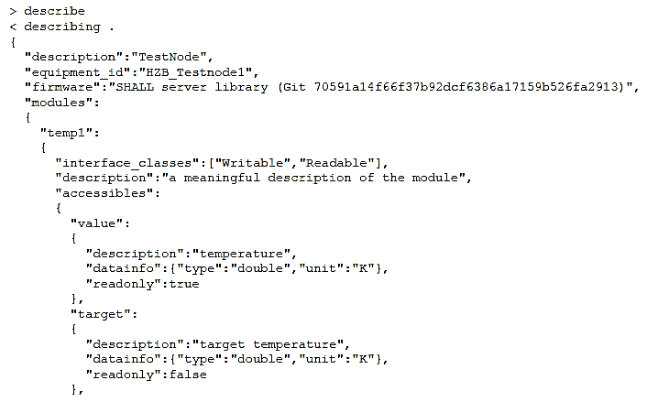
Sample Environment Communication Protocol
General description (static parameters)
List of modules (dynamic parameters) (e.g. a magnet could read/set several
temperatures and a magnetic field)
Experiment control can read
current temperature
Experiment control can set
target temperature

Slide 8
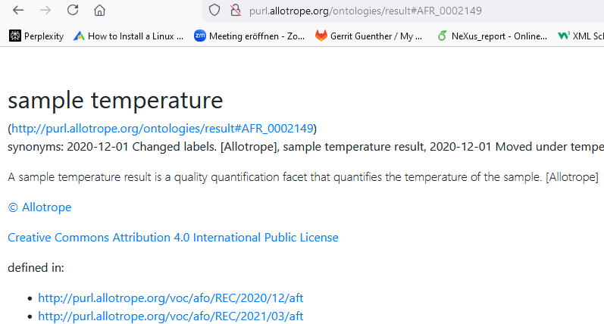
SECoP: Meaning
Each module defines what it does:
"meaning": {
"key": “sample temperature",
"link": "http://purl.allotrope.org/ontologies/result#AFR_0002149 ",
"function": "temperature_regulation",
"importance": 20,
"belongs_to": "sample" }
(human readable)
(machine readable)
(SECoP class)
(artificial parameter)
(applies to)
SE temperature (importance 5)
Sample stick temperature (importance 10)
Sample holder temperature (importance 20)
Rules:
Parameter or module property
All fields are optional
“Link” points to a specific entry, key is just an additional information
“Importance” is valid for both “function” and vocabulary “link”

Slide 9
SECoP: Meaning
Each module defines what it does:
"meaning": {
"key": “sample temperature",
"link": "http://purl.allotrope.org/ontologies/result#AFR_0002149 ",
"function": "temperature_regulation",
"importance": 20,
"belongs_to": "sample" }
(human readable)
(machine readable)
(SECoP class)
(artificial parameter)
(applies to)
SE temperature (importance 5)
Sample stick temperature (importance 10)
Sample holder temperature (importance 20)
Rules:
Parameter or module property
All fields are optional
“Link” points to a specific entry, key is just an additional information
“Importance” is valid for both “function” and vocabulary “link”

Slide 10
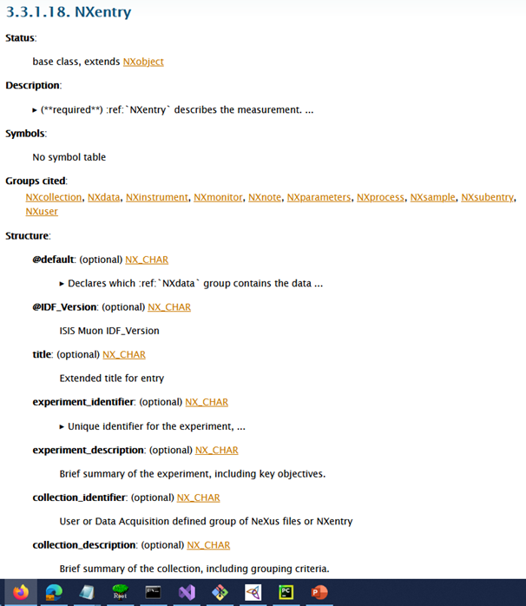
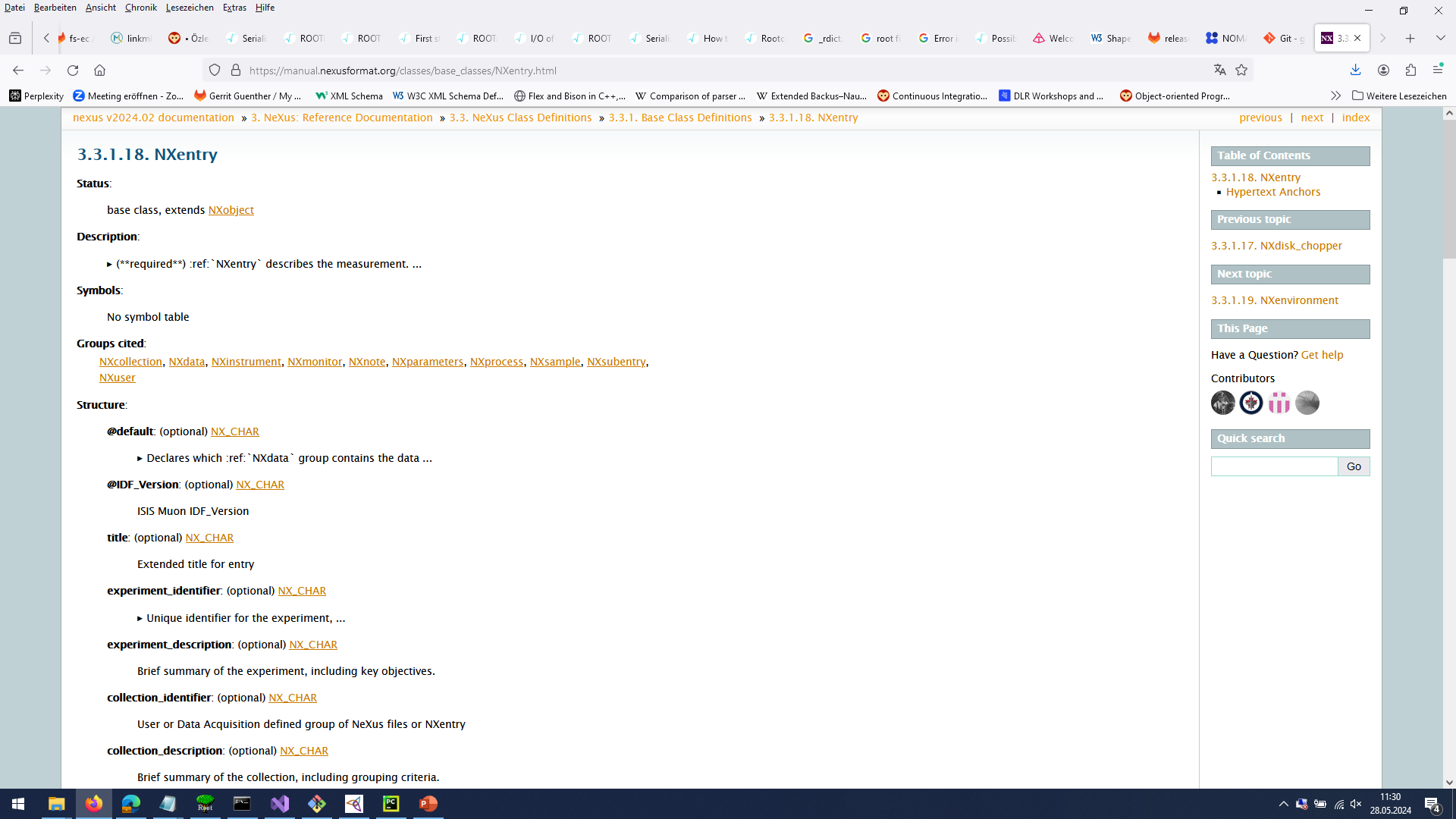
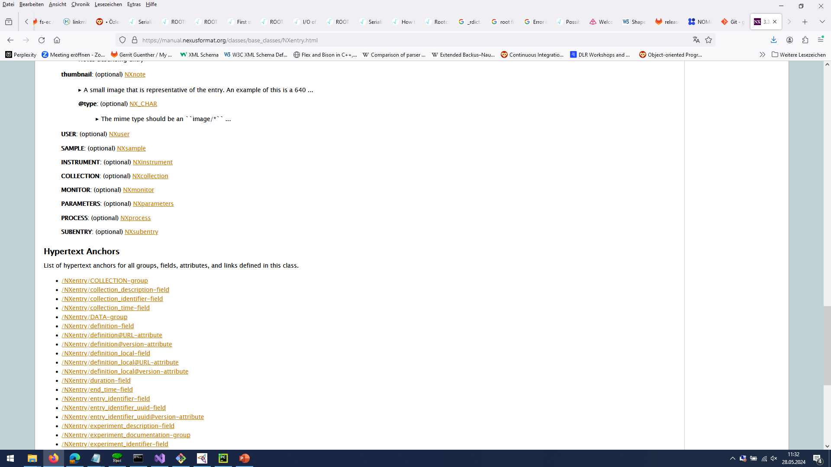
NeXus
Binary file format (HDF5)
Hierarchical, defined structure
Groups
Data Fields
@Attributes
Metadata + data create context
Persistent web description (URL)
Modular structure (base classes)
Metadata schema for experimental data
Pre-defined keys
Data Type
Meaning
Rules:
Parameter or module property
All fields are optional
“Link” points to a specific entry, key is just an additional information
“Importance” is valid for both “function” and vocabulary “link”

Slide 11
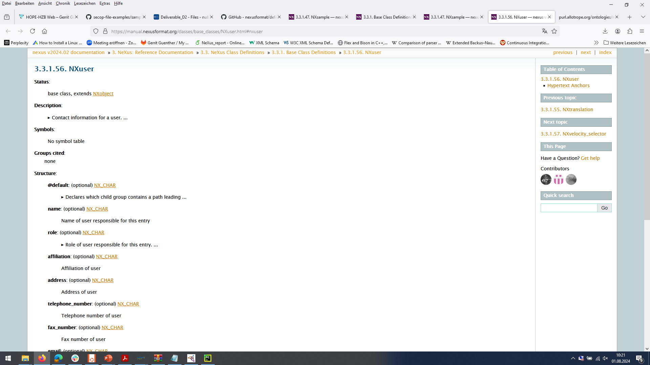
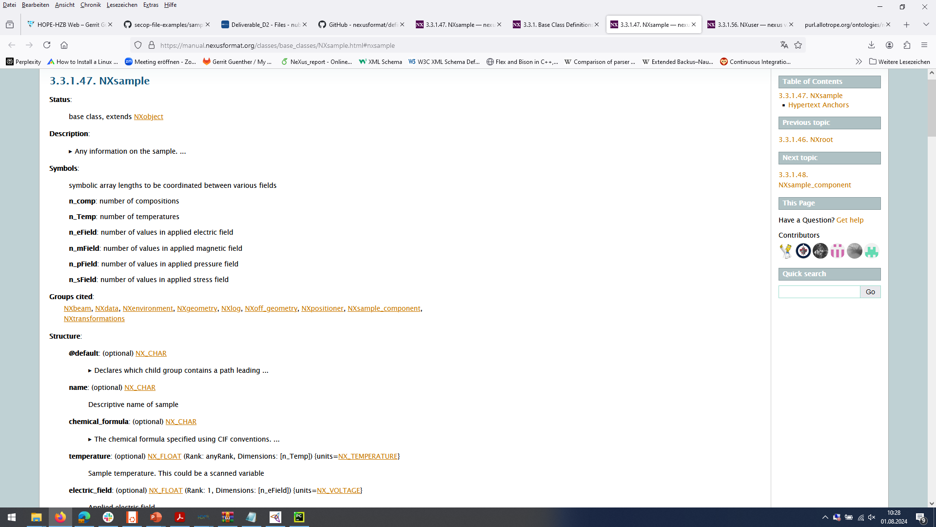
NeXus
Binary file format (HDF5)
Hierarchical, defined structure
Groups
Data Fields
@Attributes
Metadata + data create context
Persistent web description (URL)
Modular structure (base classes)
Metadata schema for experimental data: logic through structure & semantics
Rules:
Parameter or module property
All fields are optional
“Link” points to a specific entry, key is just an additional information
“Importance” is valid for both “function” and vocabulary “link”

Slide 12
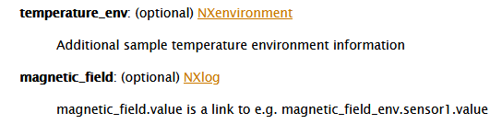
SECoP ⇨ NeXus
"meaning":
{
"key": “sample temperature",
"link": "http://purl.allotrope.org/ontologies/result#AFR_0002149 ",
"function": "temperature_regulation",
"importance": 20,
"belongs_to": "sample“
},
Rules:
Parameter or module property
All fields are optional
“Link” points to a specific entry, key is just an additional information
“Importance” is valid for both “function” and vocabulary “link”

Slide 13
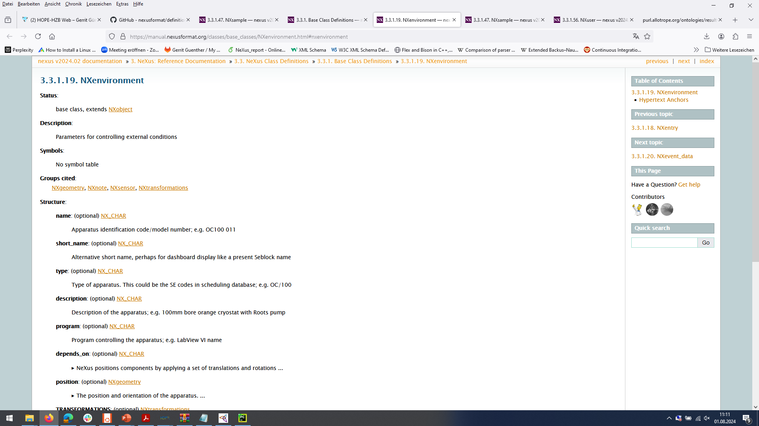
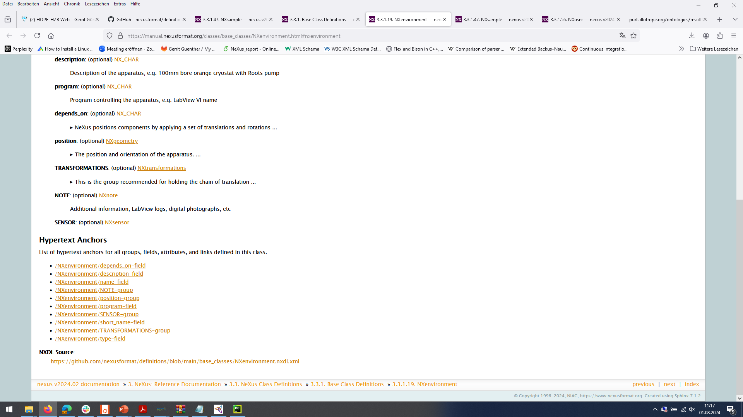
SECoP ⇨ NeXus
SECnode
"meaning":
{
"key": “sample temperature",
"link": "http://purl.allotrope.org/ontologies/result#AFR_0002149 ",
"function": "temperature_regulation",
"importance": 20,
"belongs_to": "sample“
},
Rules:
Parameter or module property
All fields are optional
“Link” points to a specific entry, key is just an additional information
“Importance” is valid for both “function” and vocabulary “link”

Slide 14
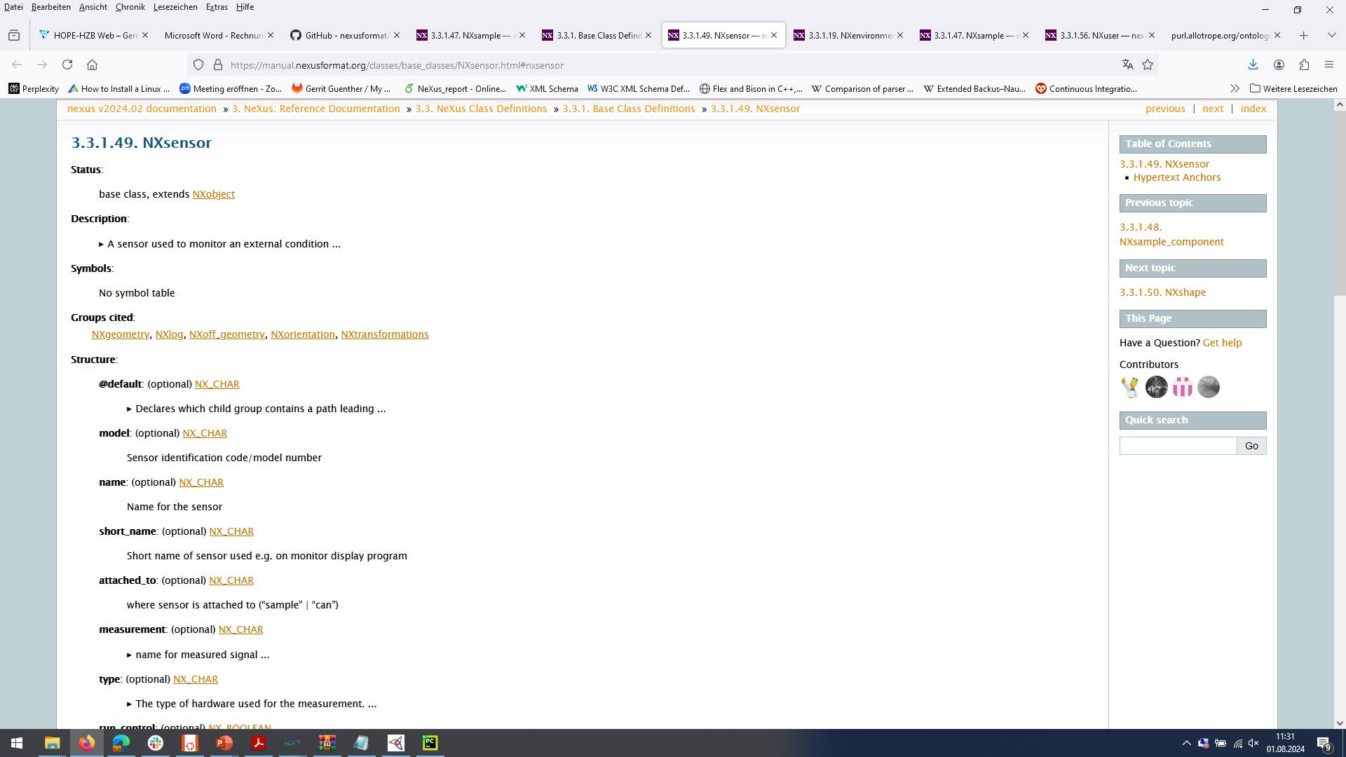
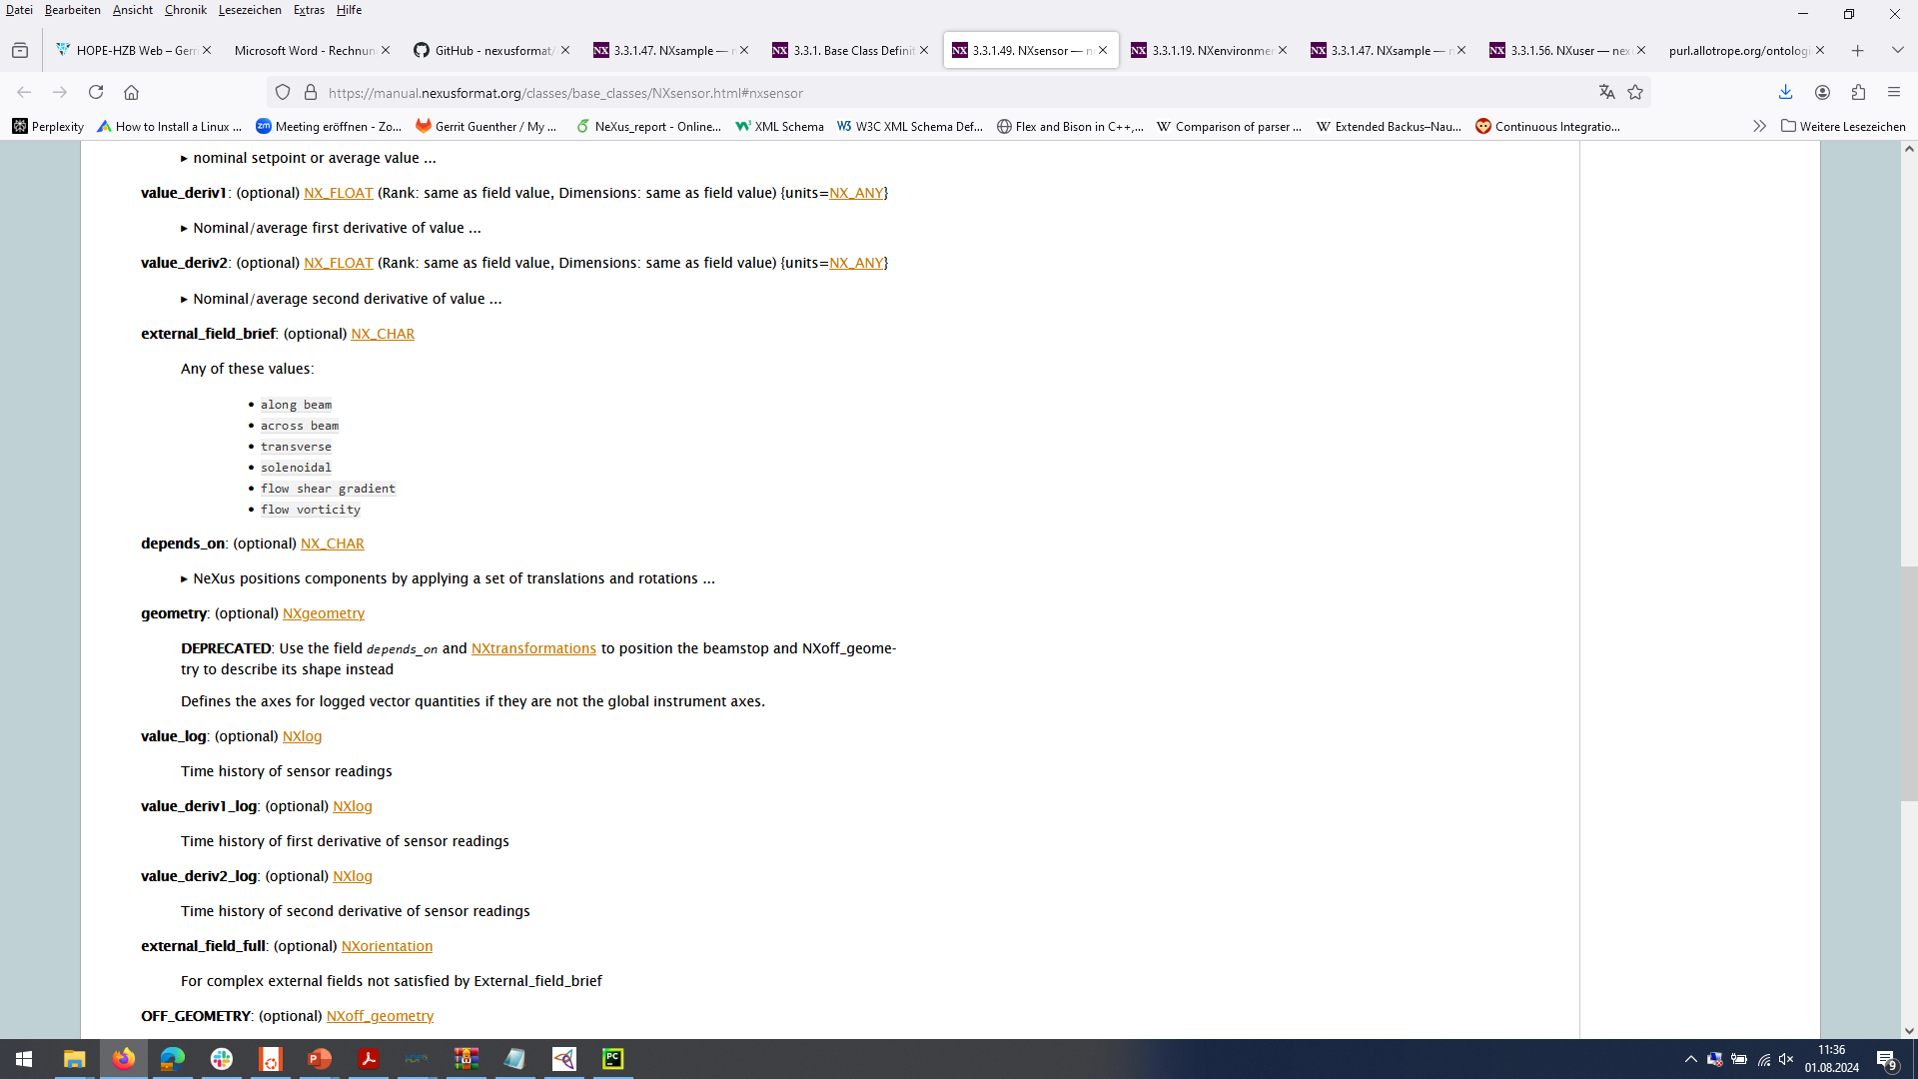
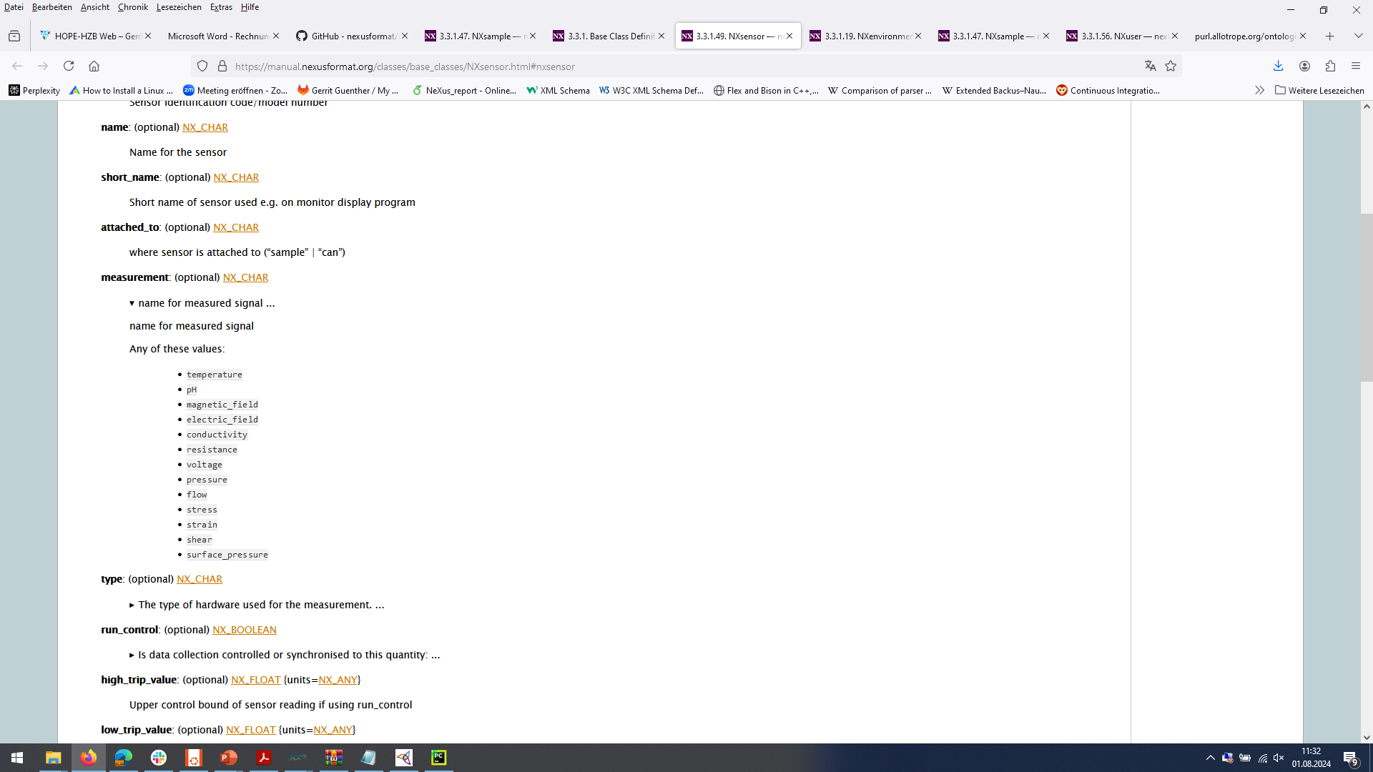
SECoP ⇨ NeXus
SECnode
Module
"meaning":
{
"key": “sample temperature",
"link": "http://purl.allotrope.org/ontologies/result#AFR_0002149 ",
"function": "temperature_regulation",
"importance": 20,
"belongs_to": "sample“
},
Rules:
Parameter or module property
All fields are optional
“Link” points to a specific entry, key is just an additional information
“Importance” is valid for both “function” and vocabulary “link”

Slide 15
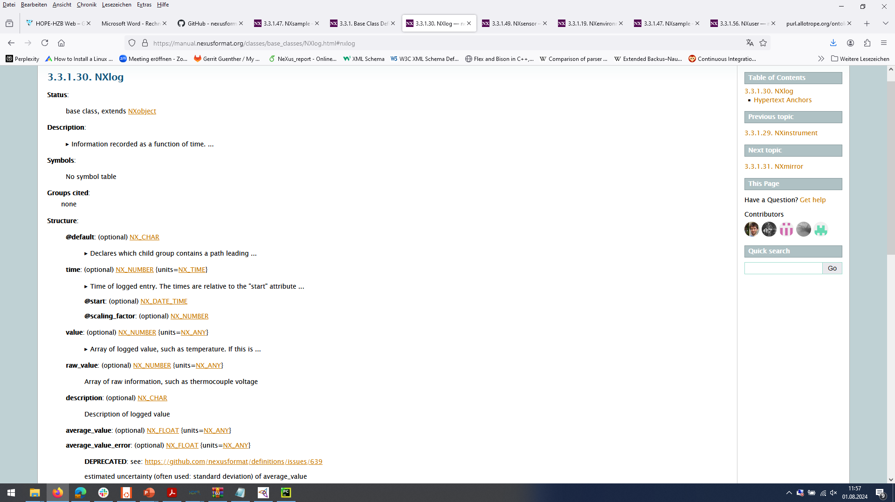
SECoP ⇨ NeXus
SECnode
Module
Parameter
"meaning":
{
"key": “sample temperature",
"link": "http://purl.allotrope.org/ontologies/result#AFR_0002149 ",
"function": "temperature_regulation",
"importance": 20,
"belongs_to": "sample“
},
Rules:
Parameter or module property
All fields are optional
“Link” points to a specific entry, key is just an additional information
“Importance” is valid for both “function” and vocabulary “link”

Slide 16
SECoP ⇨ NeXus
SECnode
Module
Parameter
"meaning":
{
"key": “sample temperature",
"link": "http://purl.allotrope.org/ontologies/result#AFR_0002149 ",
"function": "temperature_regulation",
"importance": 20,
"belongs_to": "sample“
},
Rules:
Parameter or module property
All fields are optional
“Link” points to a specific entry, key is just an additional information
“Importance” is valid for both “function” and vocabulary “link”

Slide 17
SECoP ⇨ NeXus
SECnode
Module
Parameter
"meaning":
{
"key": “sample temperature",
"link": "http://purl.allotrope.org/ontologies/result#AFR_0002149 ",
"function": "temperature_regulation",
"importance": 20,
"belongs_to": "sample“
},
Rules:
Parameter or module property
All fields are optional
“Link” points to a specific entry, key is just an additional information
“Importance” is valid for both “function” and vocabulary “link”

Slide 18
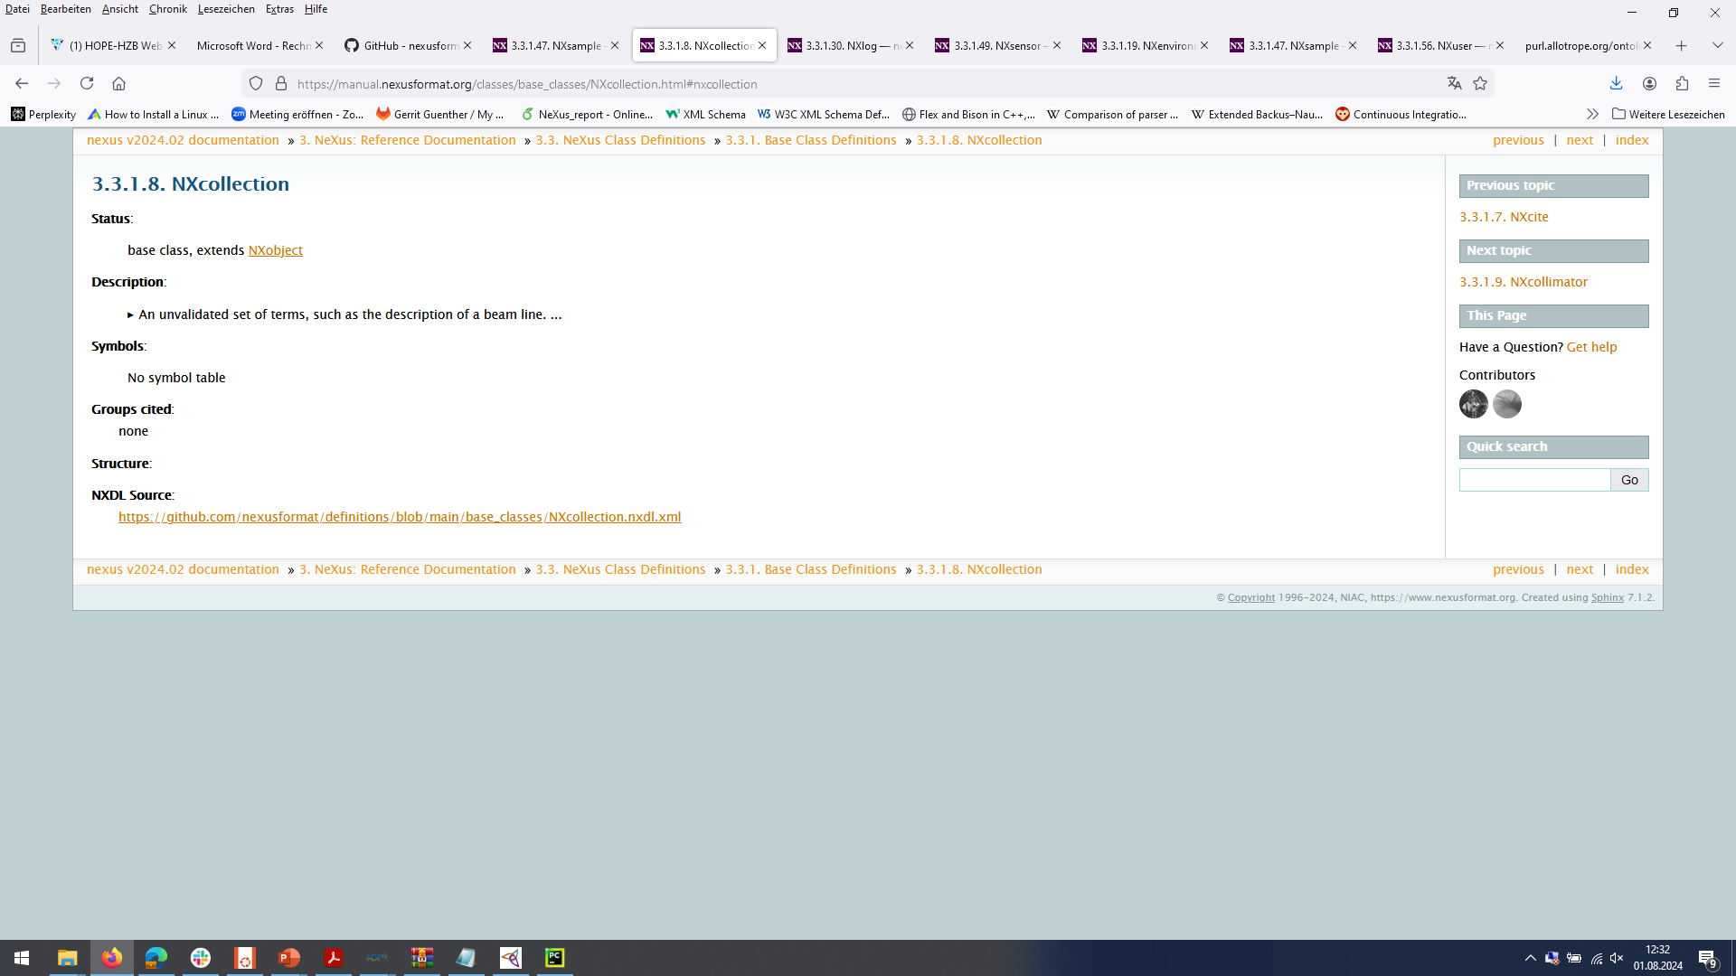
SECoP ⇨ NeXus
SECnode
Module
Parameter
"meaning":
{
"key": “sample temperature",
"link": "http://purl.allotrope.org/ontologies/result#AFR_0002149 ",
"function": "temperature_regulation",
"importance": 20,
"belongs_to": "sample“
},
Everything else
Rules:
Parameter or module property
All fields are optional
“Link” points to a specific entry, key is just an additional information
“Importance” is valid for both “function” and vocabulary “link”

Slide 19
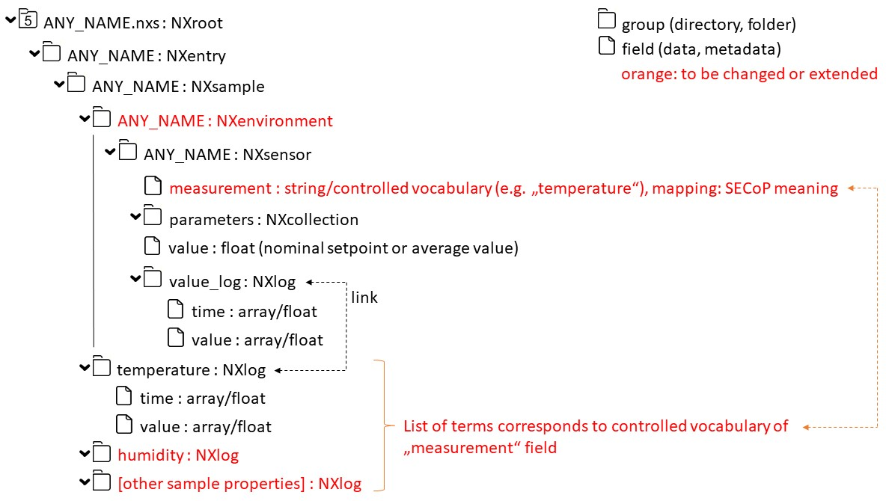
SECoP ⇨ NeXus
Required modifications:
Extension of ‚measurement‘ field ('humidity', 'viscosity', and 'concentration’)
Add corresponding fields to NXsample
Adding ‚NXenvironments‘ according to ‚measurement‘ fields (currently only temperature_env and magnetic_field_env are allowed)
Allow any ‚NXenvironment‘ (ANY_NAME : NXenvironment)
Rules:
Parameter or module property
All fields are optional
“Link” points to a specific entry, key is just an additional information
“Importance” is valid for both “function” and vocabulary “link”

Slide 20
SECoP ⇨ NeXus
Required modifications:
Extension of ‚measurement‘ field ('humidity', 'viscosity', and 'concentration’)
Add corresponding fields to NXsample
Adding ‚NXenvironments‘ according to ‚measurement‘ fields (currently only temperature_env and magnetic_field_env are allowed)
Allow any ‚NXenvironment‘ (ANY_NAME : NXenvironment)
Rules:
Parameter or module property
All fields are optional
“Link” points to a specific entry, key is just an additional information
“Importance” is valid for both “function” and vocabulary “link”

Slide 21
SECoP ⇨ NeXus: Implementation
How to implement changes?
Extension of NeXus standard:
NXDL description of changes
Proposal to NIAC through representatives
Meanwhile:
Make modified NXDL available via PID (e.g. at Zenodo)
Refer from NeXus field ‚definition_local‘ to modified NXDL
<definition xmlns="http://definition.nexusformat.org/nxdl/3.1" category="base" xmlns:xsi="http://www.w3.org/2001/XMLSchema-instance" xsi:schemaLocation="http://definition.nexusformat.org/nxdl/3.1 ../nxdl.xsd" name="NXenvironment" type="group" extends="NXobject"> <doc>Parameters for controlling external conditions</doc> <field name="name"> <doc>Apparatus identification code/model number; e.g. OC100 011</doc> </field> <field name="short_name"> <doc>Alternative short name, perhaps for dashboard display like a present Seblock name</doc> </field> <field name="type"> <doc>Type of apparatus. This could be the SE codes in scheduling database; e.g. OC/100</doc> </field> <field name="description"> <doc>Description of the apparatus; e.g. 100mm bore orange cryostat with Roots pump</doc> </field> <field name="program"> <doc>Program controlling the apparatus; e.g. LabView VI name</doc> </field> <group name="position" type="NXgeometry">
Rules:
Parameter or module property
All fields are optional
“Link” points to a specific entry, key is just an additional information
“Importance” is valid for both “function” and vocabulary “link”

Slide 22

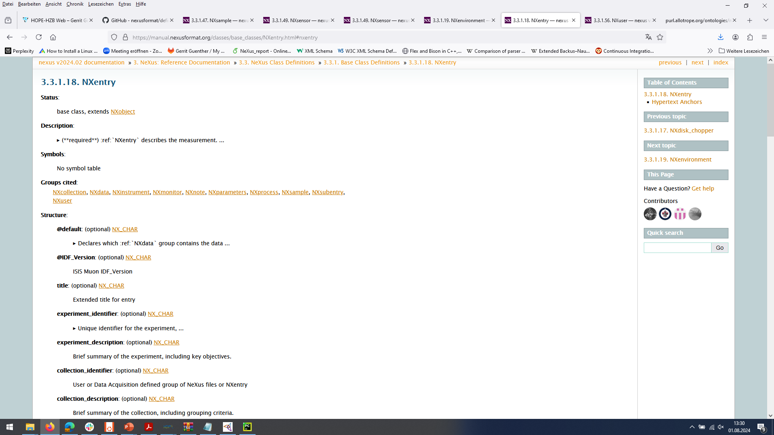
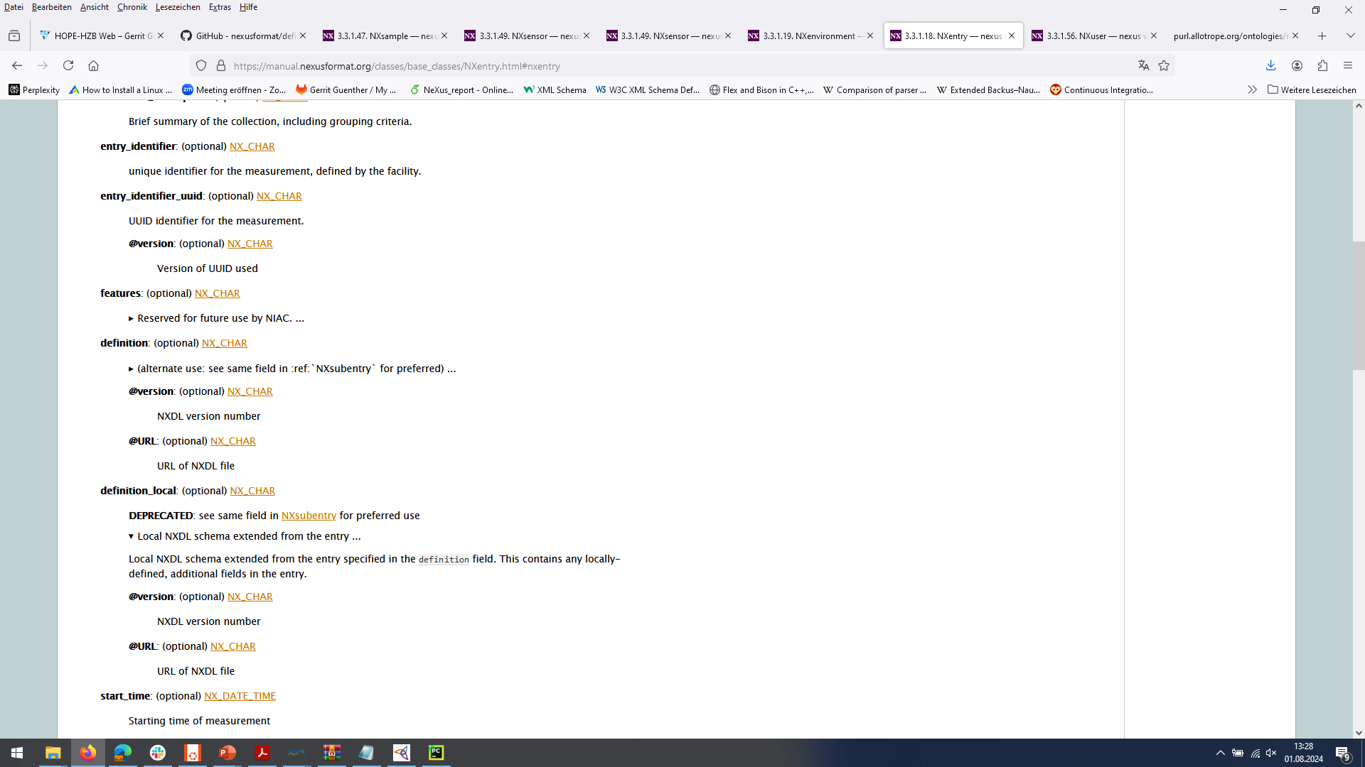
SECoP ⇨ NeXus: Implementation
How to implement changes?
Extension of NeXus standard:
NXDL description of changes
Proposal to NIAC through representatives
Meanwhile:
Make modified NXDL available via PID (e.g. at Zenodo)
Refer from NeXus field ‚definition_local‘ to modified NXDL
<definition xmlns="http://definition.nexusformat.org/nxdl/3.1" category="base" xmlns:xsi="http://www.w3.org/2001/XMLSchema-instance" xsi:schemaLocation="http://definition.nexusformat.org/nxdl/3.1 ../nxdl.xsd" name="NXenvironment" type="group" extends="NXobject"> <doc>Parameters for controlling external conditions</doc> <field name="name"> <doc>Apparatus identification code/model number; e.g. OC100 011</doc> </field> <field name="short_name"> <doc>Alternative short name, perhaps for dashboard display like a present Seblock name</doc> </field> <field name="type"> <doc>Type of apparatus. This could be the SE codes in scheduling database; e.g. OC/100</doc> </field> <field name="description"> <doc>Description of the apparatus; e.g. 100mm bore orange cryostat with Roots pump</doc> </field> <field name="program"> <doc>Program controlling the apparatus; e.g. LabView VI name</doc> </field> <group name="position" type="NXgeometry">
Rules:
Parameter or module property
All fields are optional
“Link” points to a specific entry, key is just an additional information
“Importance” is valid for both “function” and vocabulary “link”

Slide 24
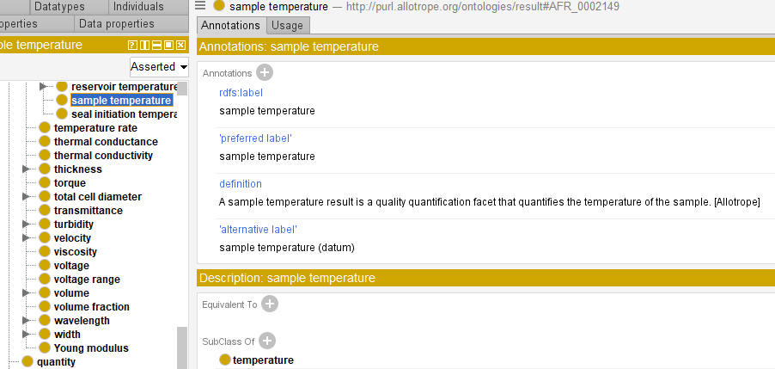
SECoP: Meaning
Each module defines what it does:
"meaning": {
"key": “sample temperature",
"link": "http://purl.allotrope.org/ontologies/result#AFR_0002149 ",
"function": "temperature_regulation",
"importance": 20,
"belongs_to": "sample" }
Rules:
Parameter or module property
All fields are optional
“Link” points to a specific entry, key is just an additional information
“Importance” is valid for both “function” and vocabulary “link”

